Slide 1
Design Patterns Basics
Douglas Bonafé
SET
07/27/2017

Slide 2
overview
Design Patterns present solutions for known programmatic problems. So, the description of a pattern ever say which problem it is solving.
All Pattern should say to us: what problem does it solve, when should be used, what's the solution.
Design Patterns emerged from the object-oriented community.
The goal of the pattern community is to build a body of literature to support design and development in general.
Notes:
2

Slide 3
overview
There is no single, standard format for documenting design patterns. Rather than, a variety of different formats have been used by different pattern authors.
According to Martin Fowler, certain pattern forms have become more well-known than others, and consequently become common starting points for new pattern-writing efforts.
Patterns names becomes the conversation between programmers easier.

Slide 4

overview
Famous names:
Martin Fowler
Erich Gamma
Richard Helm
Ralph Johson
John Vlissides
GROUP OF FOUR
(GoF)

Slide 5
Patterns? Not ever
Not ever is good to apply patterns.
Peter Norvig: 16 of 23 patterns in “Design Patterns” book are simplified or eliminated using Lisp or Dylan. [Buy here]
Inappropriate use of patterns may unnecessarily increase complexity.
Paul Graham: “Revange of the Nerds”

Slide 6
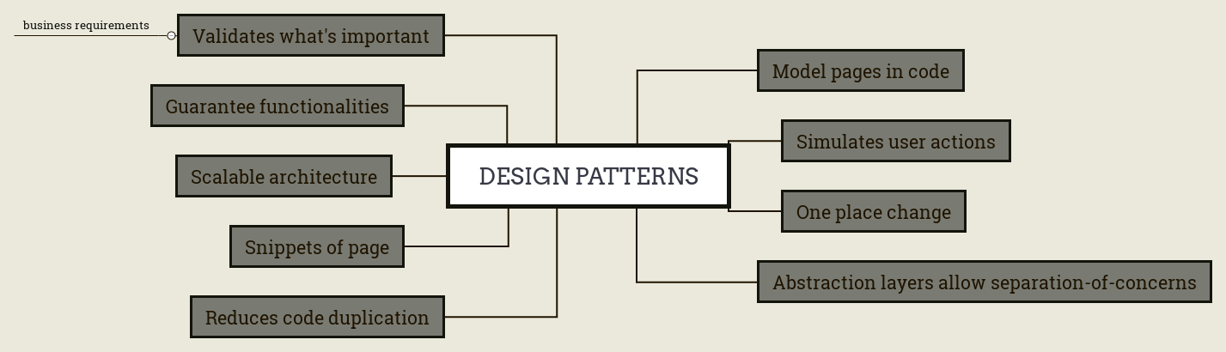
WHY TO USE PATTERNS

Slide 7
Types of patterns
Creational Patterns: help the creation of objects, becoming the program more independent of the way as the objects are created and composed.
Structural Patterns: describe flexible modes to compose classes and objects.
Behavioral Patterns: those patterns are related with algorithms and the responsibility associated with each object. When we change the used objects, we can change the behavior of program. We can attach one object to another to determine the behavior to the second.
Notes:
7

Slide 8
NOT COMMON AND NOT COMMENTED PATTERNS
Real-time Pattens
Documenting and Describing Patterns
Test Patterns
STL Design Patterns
Yahoo Design Patterns

Slide 9
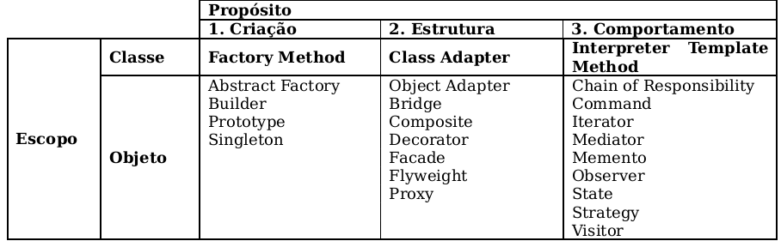
GOF OR GAMMA CLASSIFICATION
[Enzo Seraphim]

Slide 10
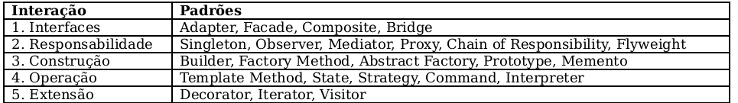
METSKER PATTERNS CLASSIFICATION
[Enzo Seraphim]

Slide 11
SOME IMPORTANT INTERFACE PATTERNS
Adapter:
Two classes with incompatible interfaces should be used together.
Facade:
Clientes of a subsystem will use only part of this functionality, so Facade will provide an easiest interface for them.

Slide 12
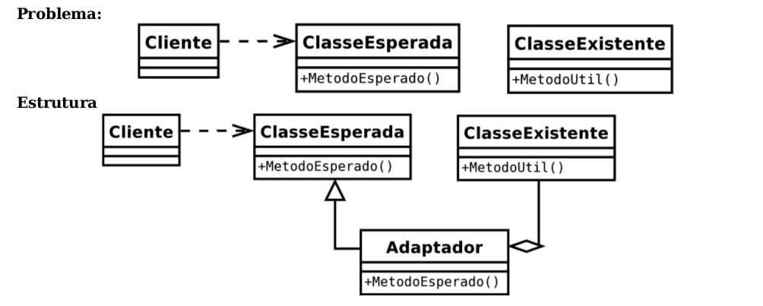
ADAPTER
[Enzo Seraphim]

Slide 13
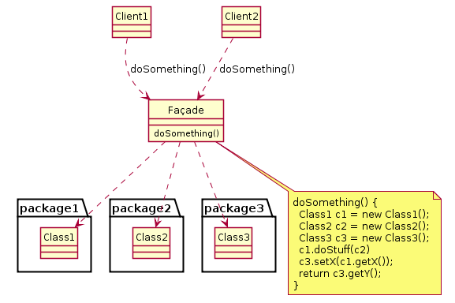
FACADE

Slide 14
PATTERNS OF RESPONSIBILITY
Singleton:
Guarantees that a class have only one instance, and provide a global access point to it.
Observer:
Defines a one-to-many dependency between objects that when an object change its state, all the objects that depends on the first be notified and updated automaticaly.
→ Consequences: there is a coupling between the subject and its observers; the observers can be added and removed in execution time.

Slide 15
PATTERNS OF RESPONSIBILITY
Proxy:
Provides a substitute or access point through witch an object could control the access to another.
Chain of Responsibility:
When various objects could answer a requirement, but the decision of who answer could only be resolved in execution time.

Slide 16
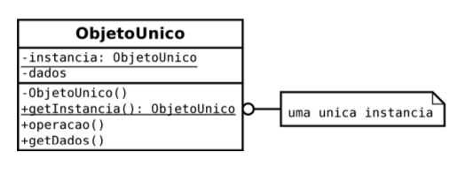
SINGLETON
[Enzo Seraphim]

Slide 17
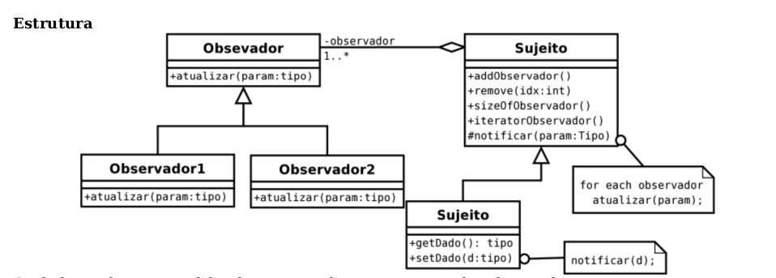
OBSERVER
[Enzo Seraphim]

Slide 18
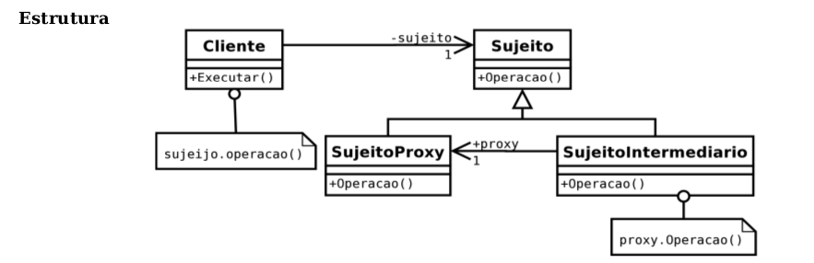
PROXY
[Enzo Seraphim]

Slide 19
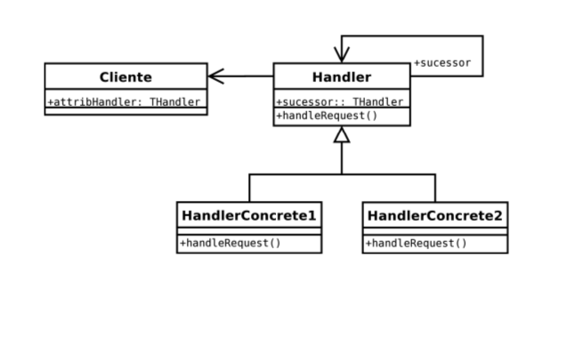
CHAIN OF RESPONSIBILITY
[Enzo Seraphim]

Slide 20
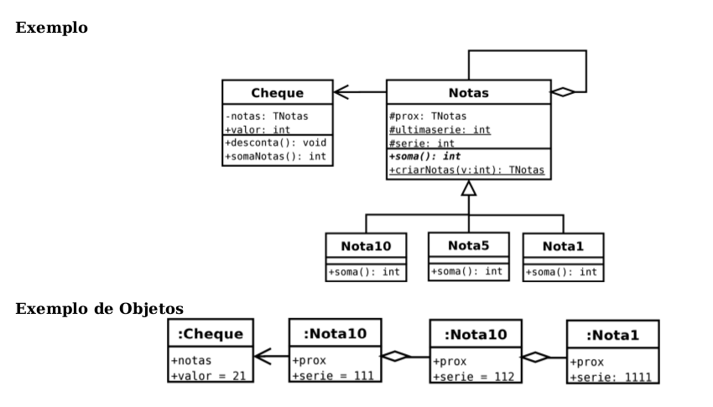
CHAIN OF RESPONSIBILITY: EXAMPLE
We'll use the chain of responsibility to orchestrate our tests.
[Enzo Seraphim]

Slide 21
PATTERNS OF BUILD
Factory Method:
Defines an interface to create an object but let that subclasses decide which class to instantiate. Factory Method allows a class to delegate the responsability to instantiate to its subclasses. Proposes to solve the problem to create an object without have any knowleadge of concrete class. Defines a common interface to create objects.
Abstract Factory:
Provides an interface o create families of related or dependent objects without to specify their concrete classes.

Slide 22
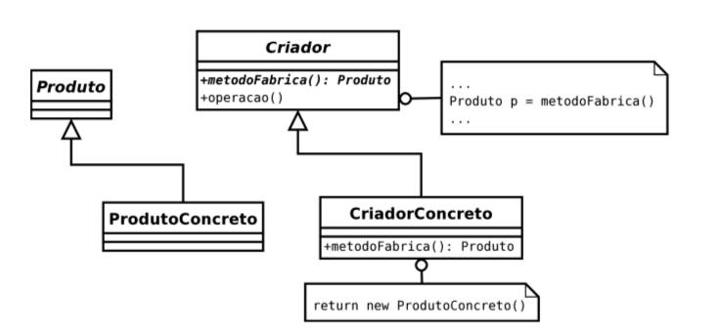
FACTORY METHOD
[Enzo Seraphim]

Slide 23
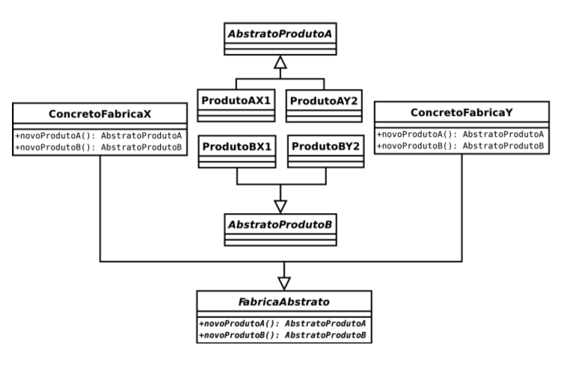
ABSTRACT FACTORY
[Enzo Seraphim]

Slide 24
SPECIFIC DESIGN PATTERN FOR TESTING
Page Object:
Encapsulates the web page into an object. The basic rule of thumb for a page object is that it should allow a software client to do anything and see anything that human can. It should also provide an interface that's easy to program to and hides the underlying widgetry in the window.
Data Object:
Encapsulates all entry data to allow the tests use not a list of separated parameters but a list of concrete objects.

Slide 25
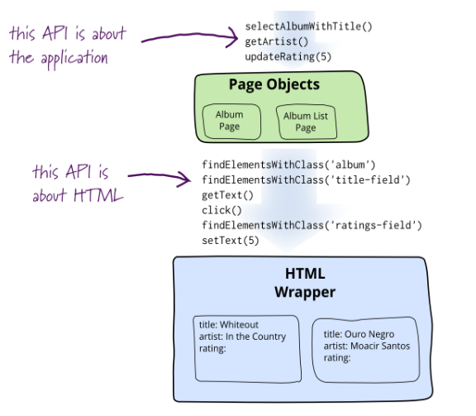
PAGE OBJECTS
http://martinfowler.com/bliki/PageObject.html

Slide 26
DATA OBJECTS
Data is complex
Needs to mimic “real” data
Needs to be unique
Data can be nested
Though specified as static, may need to be Dynamic

Slide 27
DATA OBJECTS
Data can be shared and reused
There are different ways to specify test data
In test implementation
In test specification
In code
In External files: cvs, Excel, Property, XML, YAML, Database, Json

Slide 28
PAGE FACTORY
Is an extension to the Page Object design pattern.
It's implements the Abstract Factory Design Pattern to create Page Objects.
It is used to initialize the elements of the Page Objecs itself. Annotations for elements can also be created (and recomended) as the describing properties may not always be descriptive enough to tell one object from the other.

Slide 29
PAGE FACTORY
@FindBy(how = How.ID, using = “login”)
Note: How can be used with ID, NAME, XPATH and many more
@CacheLookup
If we don't know hat element is always present on the page, it is best to use its declaration.

Slide 30
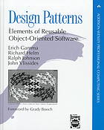
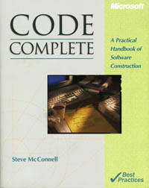
IS THAT ENOUGTH?
Obviously not! I recomend two books.

Slide 31
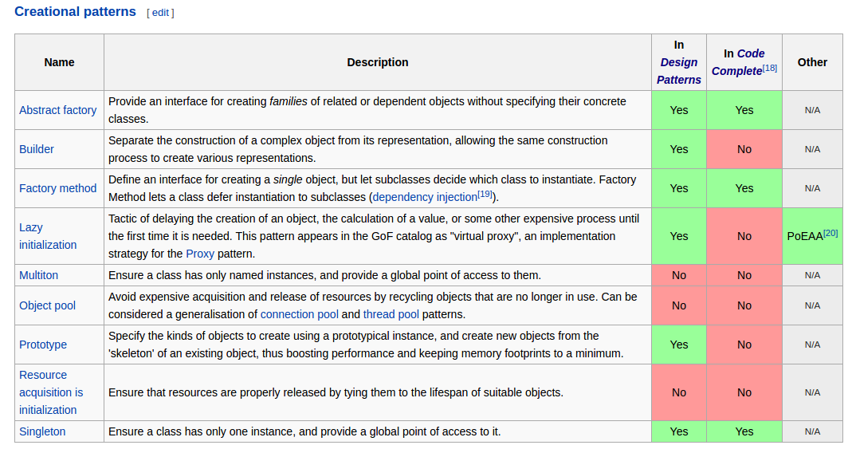
MORE PATTERNS

Slide 32
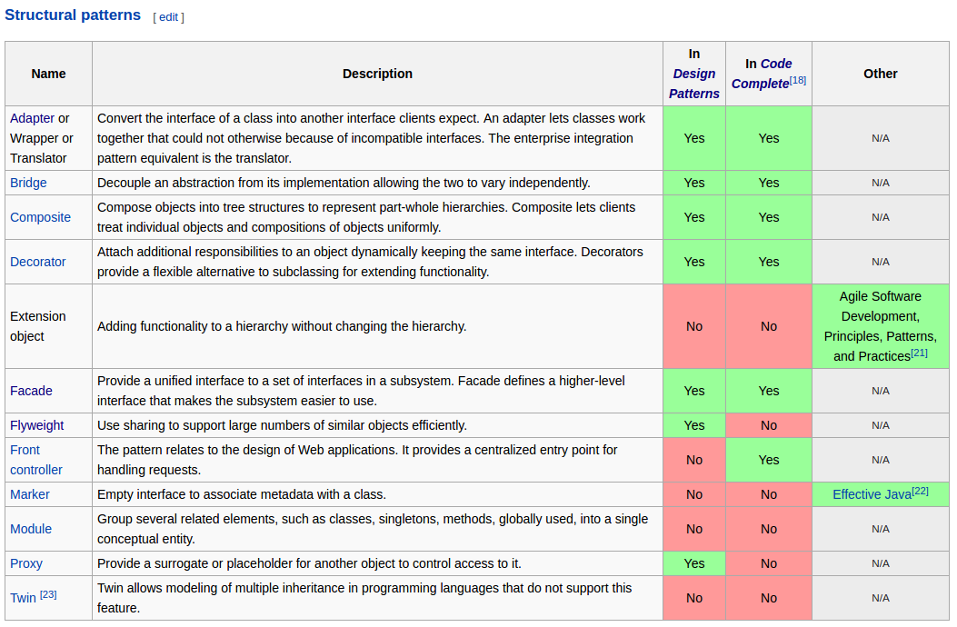
MORE PATTERNS

Slide 33
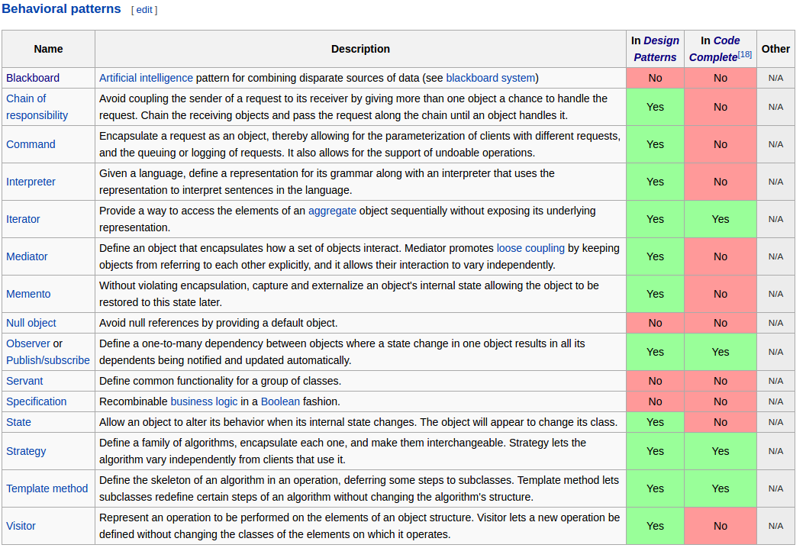
MORE PATTERNS

Slide 34
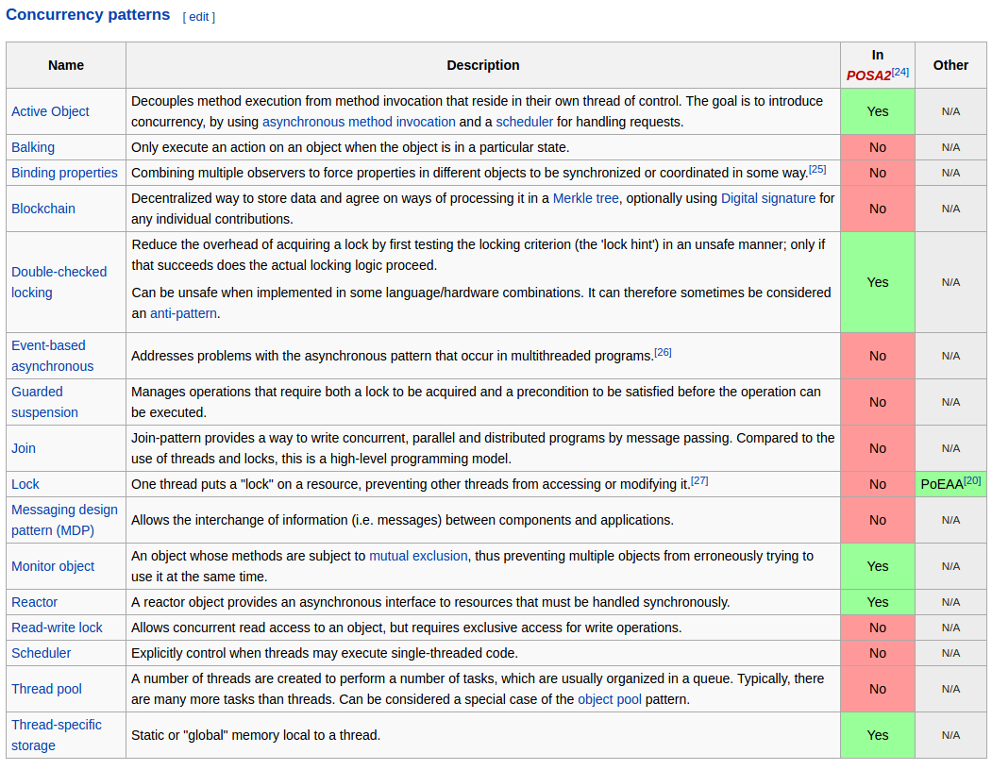
MORE PATTERNS

Slide 35
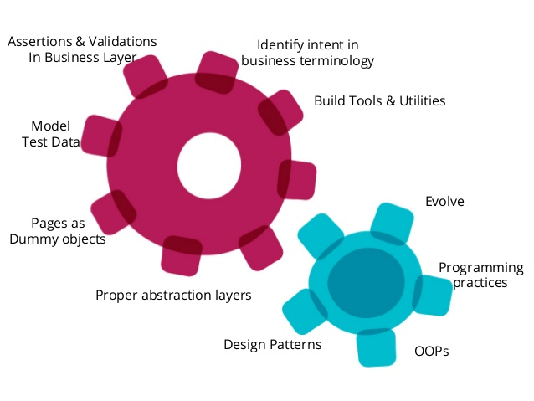
BEST PRACTICES
[Bagmar Anand]

Slide 36
BEST PRACTICES: Code Best Practices
Commenting & Documentation... BUT WITH CAUTION!
Your methods and atributes SHOULD say what they DO!
Avoid obvious and ambiguous comments!
Less comments is BETTER!
Comments is necessary!
Consistent Indentation
Code Grouping
Consistent Naming Scheme
camelCase
Underscores

Slide 37
BEST PRACTICES: DRY Principle
DO NOT REPEAT YOURSELF!!!

Slide 38
BEST PRACTICES: DRY Principle
"Every piece of knowledge must have a single, unambiguous, authoritative representation within a system."

Slide 39
BEST PRACTICES: Code Best Practices
Limit line lengght
File and folder organization
Consistent Temporary Names
Capitalize SQL Special Words
Use frameworks
Alternate Syntax Inside Templates
Code refactoring

Slide 40

BEST PRACTICES: Repository
USE GIT!!! But SVN blablabla... USE GIT!
Use a flow for GIT like Git Flow or Git Lab or Git Lab Flow.

Slide 41
BEST PRACTICES: Git Best Practices
Commit related changes
Commit often
Don’t commit Half-Done Work
Test before you commit
Write good commit messages: The messages SHOULD say what your commit done
DONT’T commit messages like: “I change the class MyClass.java”. Obviously you change it. You are commiting it, han? What did you change?

Slide 42
BEST PRACTICES: Git Best Practices
Version control is not a Backup System!!!
User workflows, branch more ONLY IF REALY NECESSARY!
MAKE ATOMIC COMMITS!!!

Slide 43
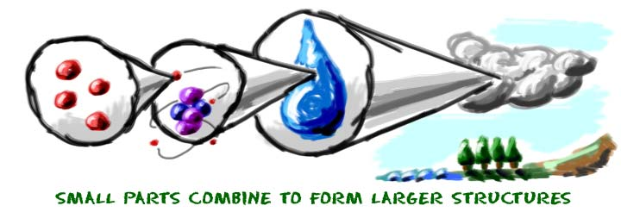
BEST PRACTICES: WHY ATOMIC COMMITS
WHAT IS IT?
Commit each fix or task as a separate change
Only commit when a block of work is complete
Commit each layout change separately
Joint commit for layout file, code behind file, and additional resources
Benefits
Easy to roll back without affecting other changes
Easy to make other changes on the fly
Easy to merge features to other branches

Slide 44
BEST PRACTICES: WHY ATOMIC COMMITS
Barney B.
http://www.barneyb.com/barneyblog/2006/01/27/atomic-commits-to-version-control/
Conifer
http://www.conifersystems.com/2008/11/05/the-benefits-of-small-commits/
Medium
https://medium.com/@fagnerbrack/one-commit-one-change-3d10b10cebbf#.cmpa6lwpm
GitHub
https://gist.github.com/SethRobertson/1540906/68feeabfe906ec1eb893e4fa45f402795ed6e62c

Slide 45
BIBLIOGRAPHY
https://sourcemaking.com/design_patterns
https://en.wikibooks.org/wiki/Introduction_to_Software_Engineering/Architecture/Design_Patterns
Bagmar Anand - http://pt.slideshare.net/abagmar/test-automation-principles-and-practices
Bagmar Anand - http://pt.slideshare.net/abagmar/patterns-in-test-automation
Martin Fowler - http://martinfowler.com/bliki/TestPyramid.html
Martin Fowler - http://www.martinfowler.com/articles/writingPatterns.html
Martin Fowler - http://martinfowler.com/bliki/PageObject.html
SouceLabs - https://saucelabs.com/resources/webinars/design-patterns-for-scalable-test-automation-with-selenium-webdriverio
Lakshay Sharma - http://toolsqa.com/selenium-webdriver/page-object-pattern-model-page-factory/
Enzo Seraphim – seraphim@unifei.edu.br
Peter Norvig - http://www.norvig.com/design-patterns/
Paul Graham – http://www.paulgraham.com/icad.html, “Revange of Nerds”

Slide 46

IN THE NEXT CHAPTER…

Slide 47

IN THE NEXT CHAPTER…

Slide 48

IN THE NEXT CHAPTER…

Slide 49
Thank you!

